Slide 1
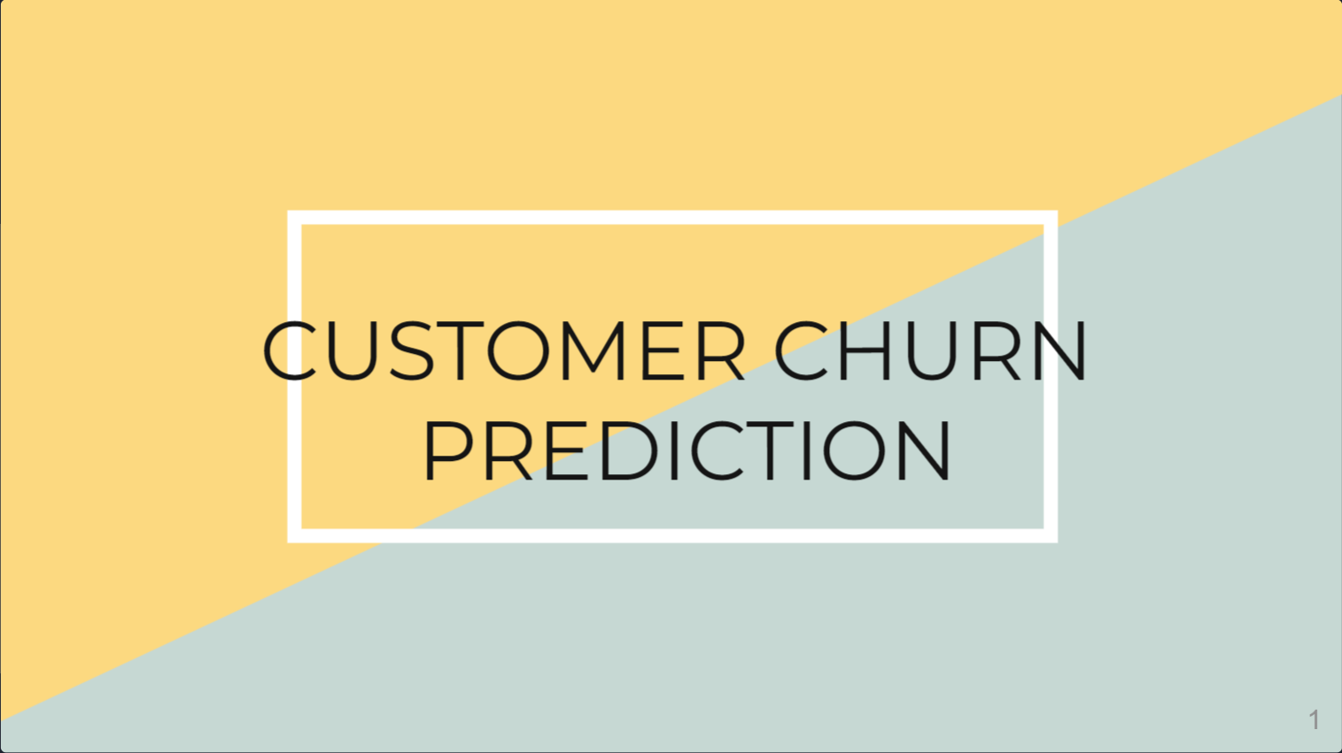

Slide 2
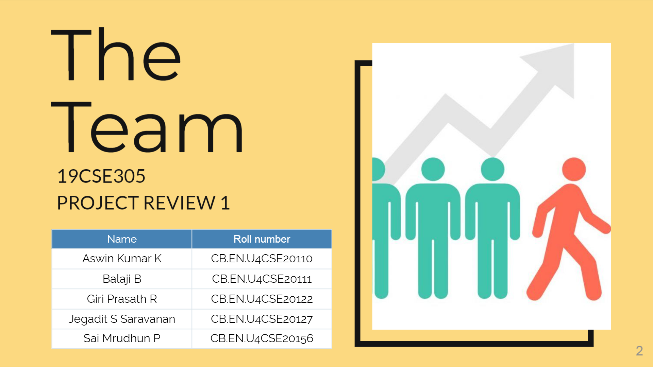

Slide 3
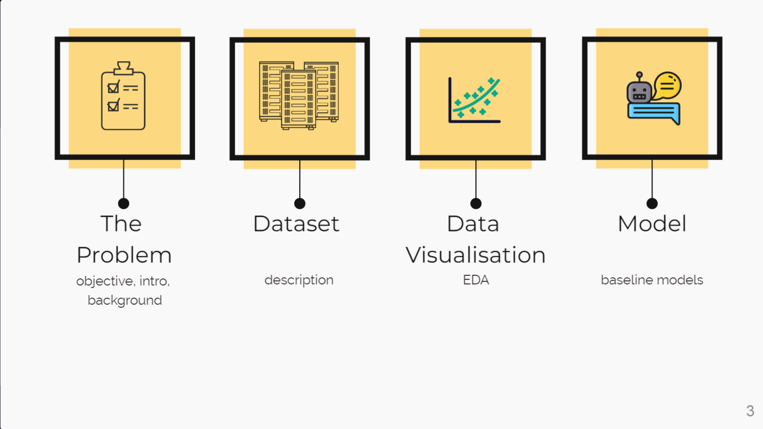

Slide 4
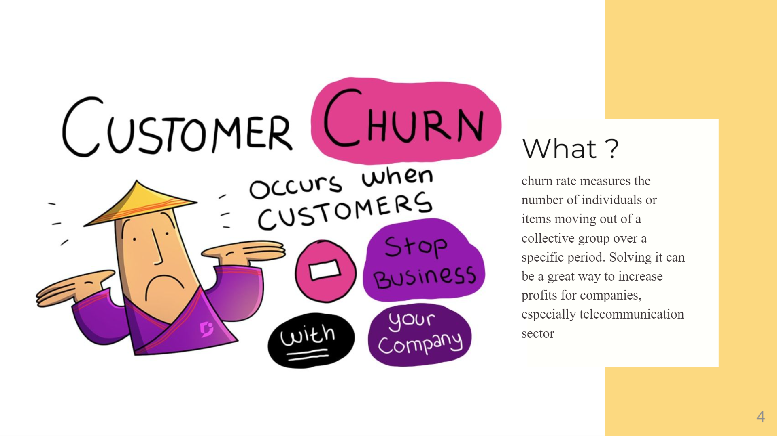

Slide 5
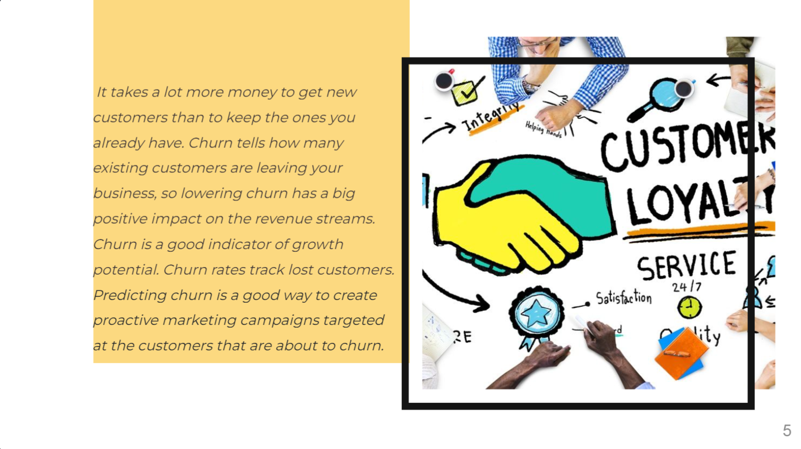

Slide 6
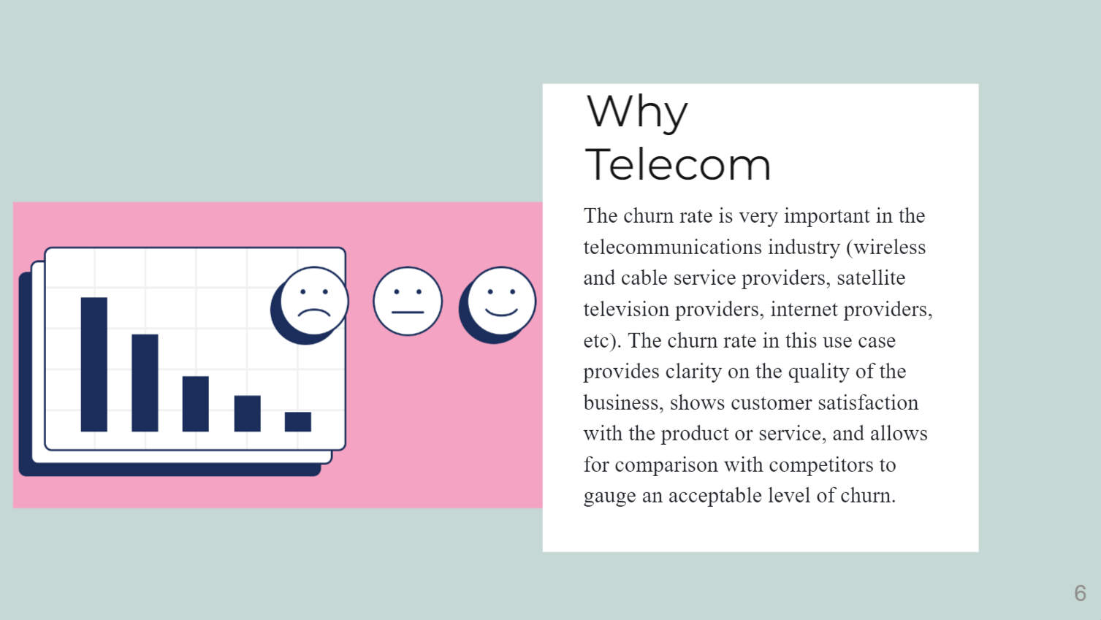

Slide 7
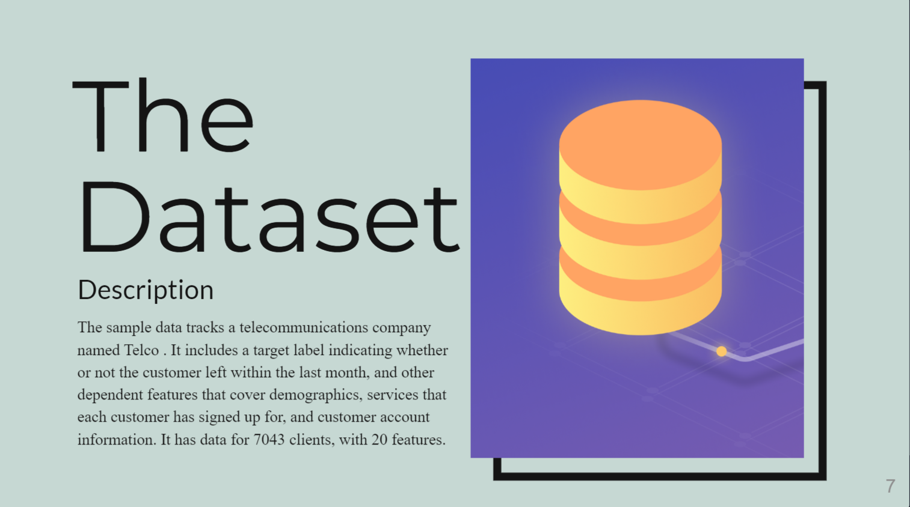

Slide 8
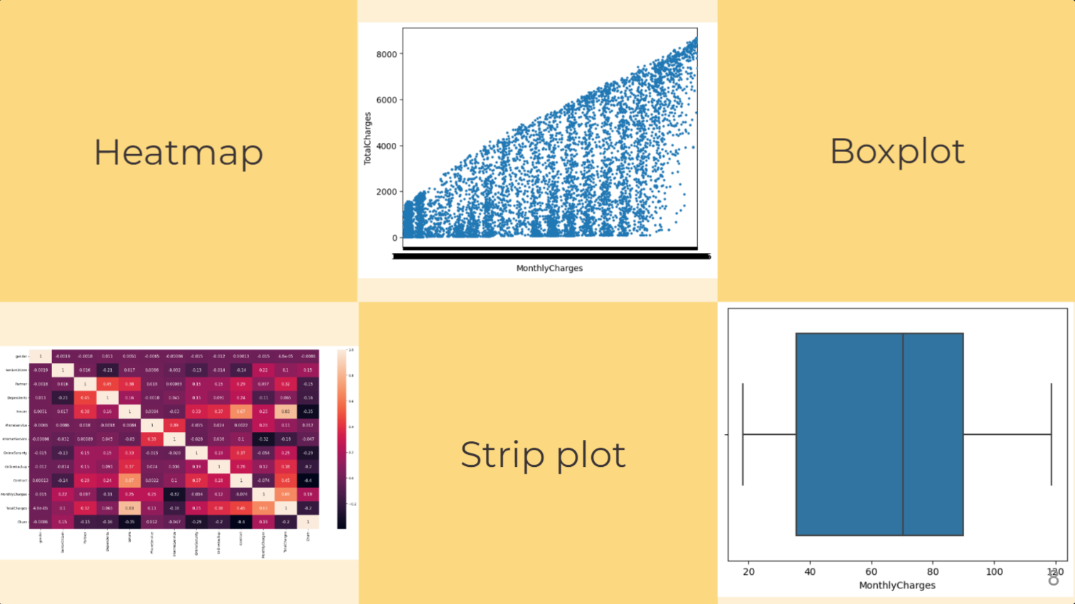

Slide 9
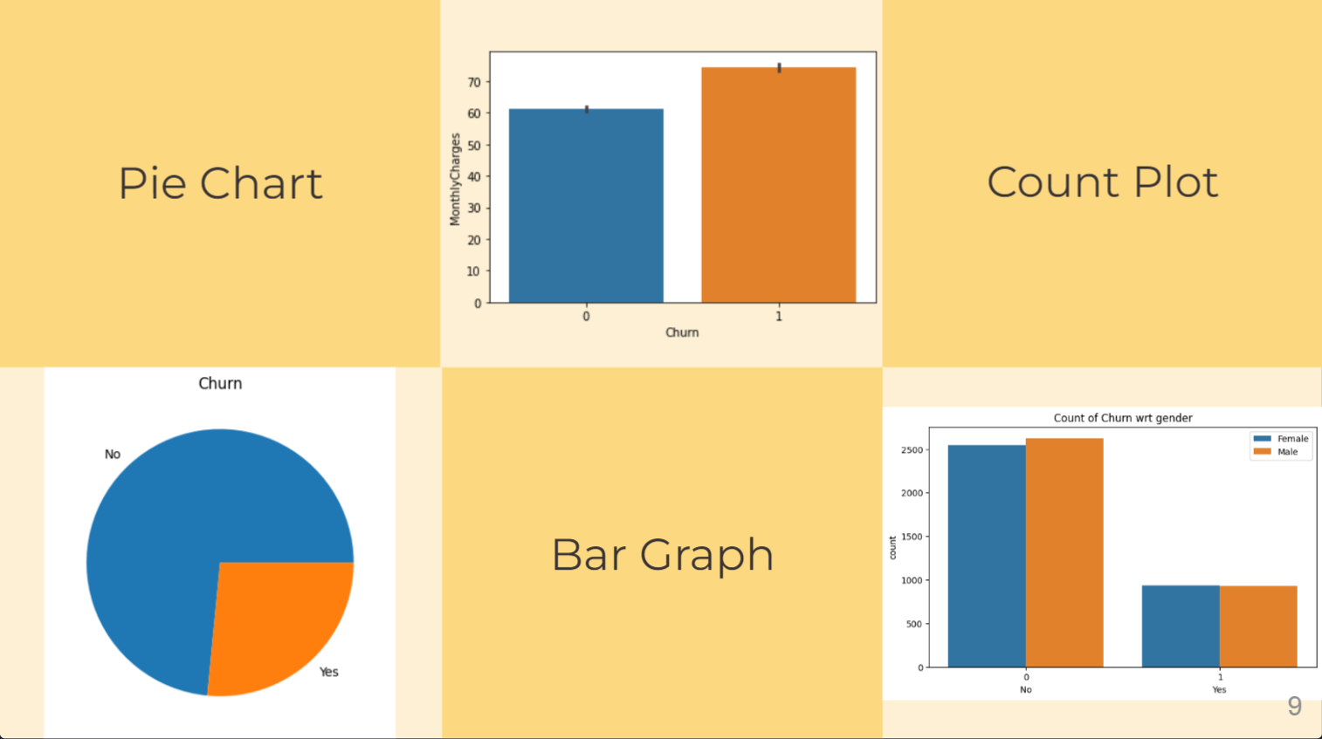

Slide 10
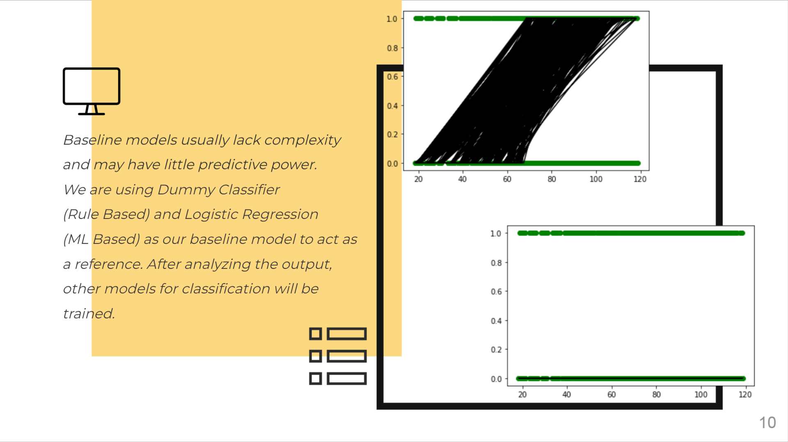

Slide 11
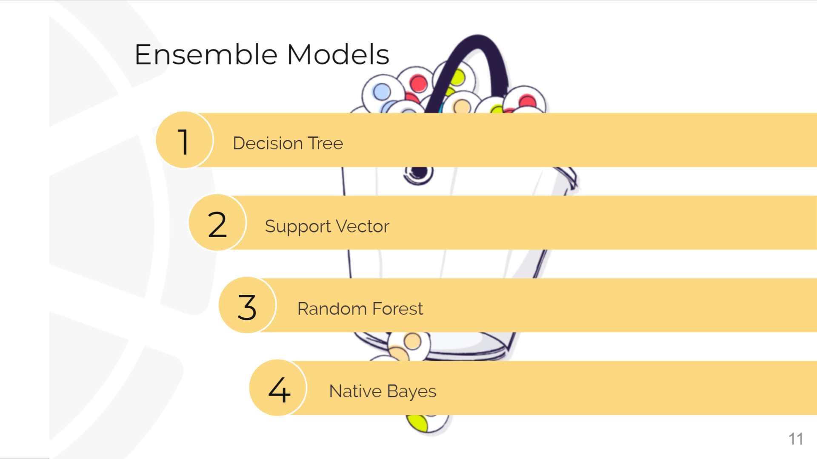

Slide 12

Information - https://www.paddle.com/resources/churn-prediction
GitHub - https://github.com/Jegadit/Customer-Churn-Prediction-Analysis-Using-Ensemble-Techniques
Dataset - https://www.kaggle.com/code/kerneler/starter-wa-fn-usec-telco-customer-05c825b4-5/data
ML - https://scikit-learn.org/stable/index.html
Visualization - https://seaborn.pydata.org/

Slide 13


